Slide 1

Prepared By Mutlu Okuducu
2020

Slide 2
What is Docker?
Docker is a container management service. The keywords of Docker are develop, ship and run anywhere. The whole idea of Docker is for developers to easily develop applications, ship them into containers which can then be deployed anywhere.
Docker is an Open platform for developers and sysadmins to build, ship and run distributed applications.
It can run on most Linux distributions, Windows and Mac OS running Docker Engine (Toolbox).

Slide 4
Docker Features….
Light-Weight
Minimal overhead (cpu/io/network)
Based on Linux containers
Decrease storage consumption
Uses layered filesystem to save space (AUFS/LVM)
Portable
Run it Everywhere! - Linux, Mac OS or Windows operating system that has Docker installed.
Raspberry pi support.
Move from one environment to another by using the same Docker technology.
Self-sufficient
A Docker container contains everything it needs to run
Minimal Base OS
Libraries and frameworks
Application code
A Docker container should be able to run anywhere that Docker can run.

Slide 5
Images - containers
Docker images are executable packages that include everything needed to run an application — the code, a runtime, libraries, environment variables, and configuration files.
Docker containers are a runtime instance of an image — what the image becomes in memory when executed (that is, an image with state, or a user process).

Slide 6
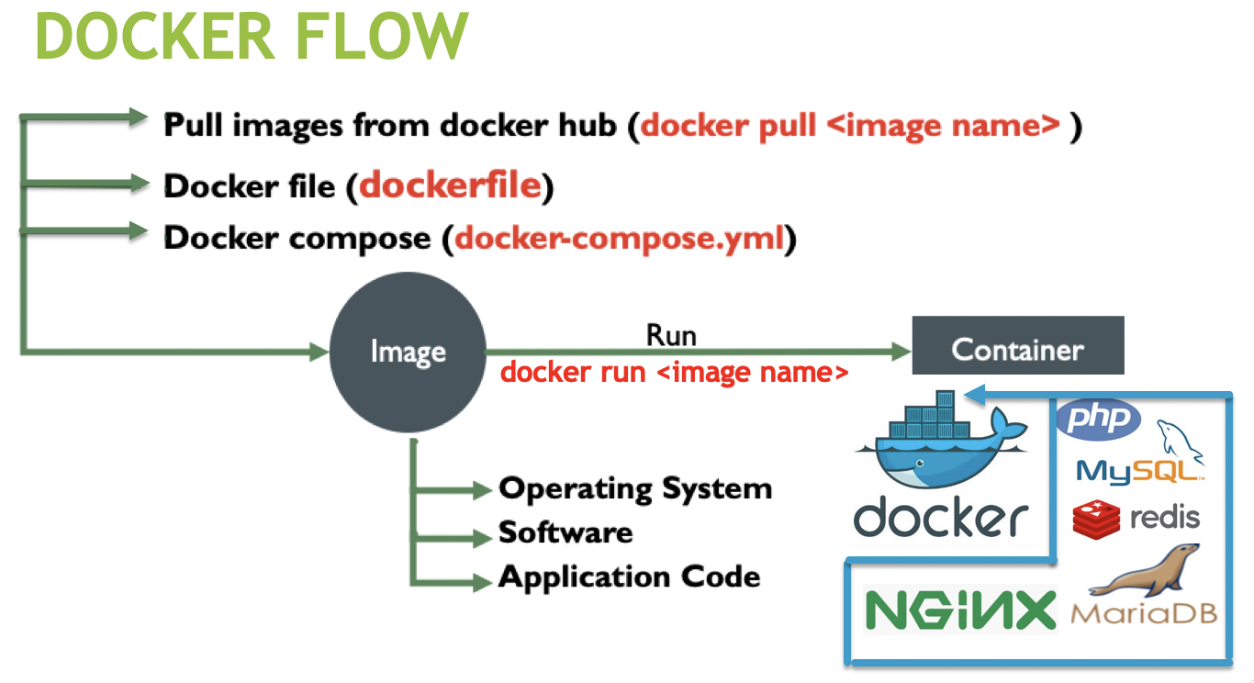
A-
B-
C-

Slide 7
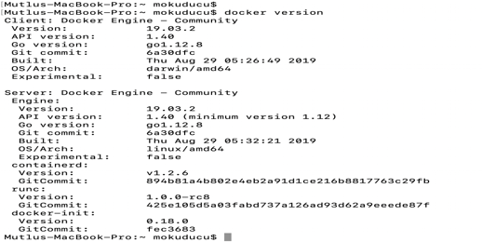
Most used commands
docker version

Slide 8
A-Docker hub
Docker Hub is a service provided by Docker for finding and sharing container images with your team.
https://hub.docker.com/

Slide 9
Docker Pull
docker pull < image name>
docker pull nginx
docker images
REPOSITORY TAG IMAGE ID CREATED SIZE
nginx latest f949e7d76d63 2 weeks ago 126MB
docker run --name nginx -d -p 8080:80 nginx
Mutlus-MacBook-Pro:~ mokuducu$ docker ps –a
CONTAINER ID IMAGE COMMAND CREATED STATUS PORTS NAMES
85a54b8a660c nginx "nginx -g 'daemon of…" About an hour ago Up 37 minutes 0.0.0.0:8080->80/tcp nginx

Slide 10
Images commands
Commands
Docker images | image list
Docker images -q | q − It tells the Docker command to return the Image ID’s only.
Docker run <images > | Imaged run details
Docker rmi -f <image id> | Force image delete
Docker history <ImageID> | History of image
Docker inspect <imageid> | Details of images

Slide 11
container commands
Commands
Docker inspect <imageid containerid> | Details of container
Docker stop | Docker stop
Docker logs <containerid> | Image logs
Docker exec <exqute command container> | Docker exequte
Docker history <ImageID > | History of image
docker top <ContainerID > | Top container
docker stats <ContainerID > | Status of container
Docker rm -f <container id> | Force image delete
docker network ls | List of network
docker network inspect <networkname > | Details of network
docker stop $(docker ps -a -q) | Stop all container
docker rm $(docker ps -a -q) | Remove all container

Slide 12
B- Docker File
Dockerfile – Text file (recipe) used to create Docker images
Docker file name must be Dockerfile

Slide 13
Docker File Commands
ADD copies the files from a source on the host into the container’s own filesystem at the set destination.
CMD can be used for executing a specific command within the container.
ENTRYPOINT sets a default application to be used every time a container is created with the image.
ENV sets environment variables.
EXPOSE associates a specific port to enable networking between the container and the outside world.
FROM defines the base image used to start the build process.
MAINTAINER defines a full name and email address of the image creator.
RUN is the central executing directive for Dockerfiles.
USER sets the UID (or username) which is to run the container.
VOLUME is used to enable access from the container to a directory on the host machine.
WORKDIR sets the path where the command, defined with CMD, is to be executed.
LABEL allows you to add a label to your docker image.

Slide 14
Build Docker File
# Ubuntu
FROM ubuntu MAINTAINER demousr@gmail.com
RUN apt-get update RUN apt-get install –y nginx CMD [“echo”,”Image created”]
•The first line "#This is a sample Image" is a comment.
•The next line has to start with the FROM keyword. It tells docker, from which base image you want to base your image from. In our example, we are creating an image from the ubuntu image.
•The next command is the person who is going to maintain this image. Here you specify the MAINTAINER keyword and just mention the email ID.
•The RUN command is used to run instructions against the image. In our case, we first update our Ubuntu system and then install the nginx server on our ubuntu image.
•The last command is used to display a message to the user.
docker build .

Slide 15
C- Docker-compose
Docker Compose is used to run multiple containers as a single service. For example, suppose you had an application which required NGNIX and Redis, you could create one file
Create Docker-Compose File at any location on your system
All Docker Compose files are YAML
File name docker-compose.yml
Install Docker Compose:
•From
github (https://github.com/docker/compose/releases)
•Using PIP
Pip install-U docker-compose

Slide 16
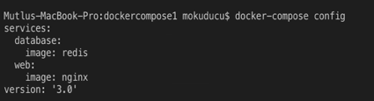
•Check docker-compose
docker-compose version (-v)
Check the validity of file by command
Docker-compose config
Run docker-compose.yml file by command
Docker-compose up –d (d Detached mode: Run containers in the background, print new container names. Incompatible with --abort-on-container-exit.)
Down Docker compose
Docker-compose down

Slide 17
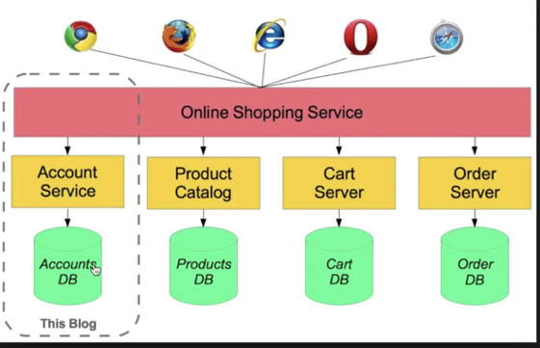
Microservices

Slide 18
Scale
scale Set number of containers for a service
docker-compose up -d --scale <service name>=number of instance
docker-compose up -d --scale database=4

Slide 19
compose commands
Commands
docker-compose -help | Help compose commands
docker-compose version (-v) | Compose version
Docker-compose config | Validate and view the Compose file
Docker-compose up –d | Create and start containers
Docker-compose down | Stop and remove containers, networks, images, and volumes
docker-compose up -d --scale <service name>=number of instance | Set number of containers for a service

Slide 20
Docker-compose Examples
#mysql and adminer
version: '3.1'
services:
db:
image: mysql
command: --default-authentication-plugin=mysql_native_password
restart: always
environment:
MYSQL_ROOT_PASSWORD: root
adminer:
image: adminer
restart: always
ports:
- 8080:8080

